Slide 1

HTML
Training
- Shilpa Kamatam
Any use, copying or distribution without written permission from UnitedHealth Group is prohibited.

Slide 2
Agenda
Definitions
What is HTML??
HTML Tags
Document Structure & Page Format
HTML Elements
HTML Attributes
Colors & Fonts
Styles
Formatting
Comments
Special Characters
Lists
Tables
Frames
Forms
Any use, copying or distribution without written permission from UnitedHealth Group is prohibited.

Slide 3
Definitions
WWW - World Wide Web is a software infrastructure layered on top of the Internet
HyperText - Structured text that uses logical links (hyperlinks) between nodes containing text.
HTTP - HyperText Transport Protocol is the protocol used to exchange or transfer HyperText.
HTTPS - Secure HTTP using encryption
HTML - HyperText Markup Language is a markup language for describing web documents (web pages).
Any use, copying or distribution without written permission from UnitedHealth Group is prohibited.

Slide 4
What is HTML??
HTML is a markup language for describing web pages. It is a set of instructions to your web browser to cause the text to be displayed in a certain way.
A markup language is a set of markup tags
HTML is not a programming language in that it doesn’t allow decisions (if statements) or loops.
You can see what the actual HTML document looks like (as opposed to how it is displayed) using the “View Source” control on the browser.
HTML documents contain HTML tags and plain text
HTML documents are also called web pages
Any use, copying or distribution without written permission from UnitedHealth Group is prohibited.

Slide 5
HTML Tags
Keywords (tag names) surrounded by angle brackets.
<tagname>content</tagname>
Ex: <html></html> , <p> </p>
HTML tags normally come in pairs indicating what is supposed to happen to the text enclosed between them like text gets bold face between <b> and </b>
The first tag in a pair is the start tag/opening tag, the second tag is the end tag/closing tag
The end tag is written like the start tag, but with a slash before the tag name
Pairs of tags are supposed to be nested i.e.; you close all inner tags before closing outer tags. Thus,
<b><i>bold and italicize</i></b> CORRECT
<b><i>bold and italicize</b></i> WRONG
Any use, copying or distribution without written permission from UnitedHealth Group is prohibited.

Slide 6
HTML Tags
HTML tags are case-insensitive: <table>, <TABLE>, and <tAbLE> are all equivalent. However, the current XHTML standard suggests that we should use small letters: <table>.
Some tags don’t have a closing tag. <br>, a line break, is a common example. The XHTML standard suggests putting a slash into the single tag in these cases: <br />.
Any use, copying or distribution without written permission from UnitedHealth Group is prohibited.

Slide 7
HTML Document Structure
HTML documents are supposed to have the form of a tree, or equivalently, in the form of a set of nested tags.
The document should open with <html> and close with </html>
Within the <html> tags are 2 sections: <head> ... </head> and <body> ... </body>.
In the head section is a <title> ... </title> line. The title is displayed at the very top of the browser window.
The body section contains all the tags and text that are displayed in the main window.
The DOCTYPE declaration defines the document type. It helps the browser to display a web page correctly. There are different document types on the web. To display a document correctly, the browser must know both type and version. The doctype declaration is not case sensitive. No end tag.
Ex: HTML5
<!DOCTYPE html>
HTML 4.01
<!DOCTYPE HTML PUBLIC "-//W3C//DTD HTML 4.01 Transitional//EN"
"http://www.w3.org/TR/html4/loose.dtd">
Any use, copying or distribution without written permission from UnitedHealth Group is prohibited.

Slide 8
Page Format
<!DOCTYPE html>
<html>
<head>
<title>Page Title</title>
</head>
<body>
<h1>My First Heading</h1>
<!-- Rest of page goes here. This is a comment. -->
</body>
</html>
Any use, copying or distribution without written permission from UnitedHealth Group is prohibited.

Slide 9
HTML Elements - Headings
HTML Headings are defined with the <H1> to <H6> tags. H1 being the largest and H6 being the smallest.
ALIGN=“<position>” it can be left, center or right. The default is left.
  <HTML>
  <HEAD>
  <TITLE>Document Headings</TITLE>
  </HEAD>
  <BODY>
  Samples of the six heading types:
  <H1>Level-1 (H1)</H1>
  <H2 ALIGN="center">Level-2 (H2)</H2>
  <H3><U>Level-3 (H3)</U></H3>
  <H4 ALIGN="right">Level-4 (H4)</H4>
  <H5>Level-5 (H5)</H5>
  <H6>Level-6 (H6)</H6>
  </BODY>
  </HTML>
Any use, copying or distribution without written permission from UnitedHealth Group is prohibited.

Slide 10
HTML Elements - Paragraph
HTML paragraphs are defined with the <p> tag. </p> is optional.
ALIGN=“<position>” it can be left, center or right. The default is left.
  <!DOCTYPE html>
  <html>
  <body>
  <p>This is a paragraph.</p>
  <p>This is a paragraph.</p>
  <p>This is a paragraph.</p>
  </body>
  </html>
Any use, copying or distribution without written permission from UnitedHealth Group is prohibited.

Slide 11
HTML Elements
Line Breaks
The HTML <br> element defines a line break.
Use <br> if you want a line break (a new line) without starting a new paragraph
Ex: <p>This is<br>a para<br>graph with line breaks</p>
<pre> element
The HTML <pre> element defines a block of pre-formatted text, with structured spaces and lines.
To display anything, with right spacing and line-breaks, you must wrap the text in a <pre> element:
Ex: <pre>
if (a < b) {
a++;
b = c * d;
}
</pre>
Any use, copying or distribution without written permission from UnitedHealth Group is prohibited.

Slide 12
HTML Attributes
Attributes provide additional information about an element
Attributes are always specified in the start tag
Attributes come in name/value pairs like: name="value"
For example: <h2 align=“center”>Title</h2> creates a centered headline. The default is left-justified.
Title Attribute –
The <p> element has a title attribute.
<p title=“Optum">
Optum is a technology division of United Health Group, which is a Health care Insurance company based in US.
</p>
Align Attribute -
To align the text. Default is always “left”. You can have “center” and “right” too by using align.
Ex: <h1 align=“center”>United Health Group</h1>
Any use, copying or distribution without written permission from UnitedHealth Group is prohibited.

Slide 13
HTML Attributes
Anchor tag & href Attribute –
HTML hyperlinks are defined with the <a> tag. The link address is specified in the href attribute.
Ex: <a href="http://www.google.com">This is a link</a>
Image tag, Src & Size Attributes –
HTML images are defined with the <img> tag.
The filename of the source (src), and the size of the image (width and height) are all provided as attributes
Ex: <img src=“abc.jpg" width="104" height="142">
alt Attribute –
The alt attribute specifies an alternative text to be used, when an HTML element cannot be displayed.
Ex: <img src=“abc.jpg" alt=“ABC.com" width="104" height="142">
Any use, copying or distribution without written permission from UnitedHealth Group is prohibited.

Slide 14
Colors & Fonts
Values for BGCOLOR and COLOR
  many are predefined (red, blue, green, ...)
  all colors can be specified as a six character hexadecimal value: RRGGBB
  FF0000 – red 888888 – gray 004400 – dark green
  FFFF00 – yellow
<FONT COLOR="red" SIZE="2" FACE="Times Roman">
This is the text of line one </FONT>
<FONT COLOR="green" SIZE="4" FACE="Arial">
Line two contains this text </FONT>
<FONT COLOR="blue" SIZE="6" FACE="Courier"
The third line has this additional text </FONT>
Note: <FONT> is now deprecated in favor of CSS.
Any use, copying or distribution without written permission from UnitedHealth Group is prohibited.

Slide 15
HTML Styles
Every HTML element has a default style (background color is white, text color is black, text-size is 12px ...) . The default style of an HTML element can be changed by using the style attribute. It has following syntax.
style="property:value"
Ex:
<body style="background-color:lightgrey">
<h1 style="color:blue">This is a heading</h1>
<p style="font-family:courier">This is a paragraph.</p>
<h2 style="font-size:300%">This is a heading</h2
<h3 style="text-align:center">Centered Heading</h3>
</body>
Use background-color for background color
Use color for text colors
Use font-family for text fonts
Use font-size for text sizes
Use text-align for text alignment
Any use, copying or distribution without written permission from UnitedHealth Group is prohibited.

Slide 16
HTML Formatting & HTML Comments
HTML Formatting –
<b> element defines bold text.
Ex: <p><b>This text is bold</b>.</p>
<i> element defines italic text
Ex: <p><i>This text is italic</i>.</p>
Small - <small>
Subscript - <sub>
Superscript - <sup>
Strong - <strong>
Emphasized - <em>
HTML Comments – Comments are not displayed by the browser, but they can help document your HTML. Also helps in debugging.
Ex: <!-- This is a comment -->
Any use, copying or distribution without written permission from UnitedHealth Group is prohibited.

Slide 17
Special Characters
Character | Use
< | &lt;
> | &gt;
& | &amp;
" | &quot;
Space | &nbsp;
Any use, copying or distribution without written permission from UnitedHealth Group is prohibited.

Slide 18
HTML Lists
Lists may contain:
<ul> - An unordered list. This will list items using plain bullets.
<ol> - An ordered list. This will use different schemes of numbers to list your items.
<dl> - A description list. This arranges your items in the same way as they are arranged in a dictionary.
Unordered HTML List –
An unordered list is a collection of related items that have no special order or sequence. This list is created by using HTML <ul> tag. Each item in the list is marked with a bullet.
<ul>
<li>Coffee</li>
<li>Tea</li>
<li>Milk</li>
</ul>
Any use, copying or distribution without written permission from UnitedHealth Group is prohibited.

Slide 19
HTML Lists
Type Attribute-
You can use type attribute for <ul> tag to specify the type of bullet you like. By default it is a disc. Following are the possible options:
<ul type="square">
<ul type="disc">
<ul type="circle">
Ex: <ul type="square">
<li> Tea </li>
<li> Coffee </li>
<li> Milk </li>
</ul>
Any use, copying or distribution without written permission from UnitedHealth Group is prohibited.

Slide 20
HTML Lists
Ordered Lists –
To put your items in a numbered list instead of bulleted then HTML ordered list will be used.
This list is created by using <ol> tag. Each list item starts with the <li> tag.
<ol>
<li>Coffee</li>
<li>Milk</li>
</ol>
Type –
A type attribute can be added to an ordered list, to define the type of the marker
type="1“ → Default
type="A“ → Upper Case Alphabets
type="a“ → Lower Case Alphabets
type="I“ → Upper Case Roman Numbers
type="i“ → Lower Case Roman Numbers
Any use, copying or distribution without written permission from UnitedHealth Group is prohibited.

Slide 21
HTML Lists
Description Lists –
A description list, is a list of terms, with a description of each term.
The <dl> tag defines a description list.
The <dt> tag defines the term (name), and the <dd> tag defines the data (description).
Ex:
<dl>
<dt>Coffee</dt>
<dd>- black hot drink</dd>
<dt>Milk</dt>
<dd>- white cold drink</dd>
</dl>
Lists can be nested inside lists
List items can contain other HTML elements
Use the CSS property display:inline to display a list horizontally
Any use, copying or distribution without written permission from UnitedHealth Group is prohibited.

Slide 22
HTML Tables
<TABLE> table tag
<CAPTION> optional table title
<TR> table row
<TH> table column header
<TD> table data element
Ex:
  <TABLE BORDER=1>
  <CAPTION>Table Caption</CAPTION>
  <TR><TH>Heading1</TH> <TH>Heading2</TH></TR>
  <TR><TD>Row1 Col1 Data</TD><TD>Row1 Col2 Data</TD></TR>
  <TR><TD>Row2 Col1 Data</TD><TD>Row2 Col2 Data</TD></TR>
  <TR><TD>Row3 Col1 Data</TD><TD>Row3 Col2 Data</TD></TR>
  </TABLE>
Any use, copying or distribution without written permission from UnitedHealth Group is prohibited.

Slide 23
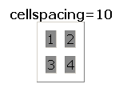
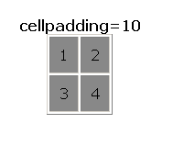
<table> Element Attributes
ALIGN=position -- left, center, right for table
BORDER=number -- width in pixels of border (including any cell spacing, default 0)
CELLSPACING=number -- spacing in pixels between cells, default about 3
CELLPADDING=number -- space in pixels between cell border and table element, default about 1
WIDTH=number[%]-- width in pixels or percentage of page/frame width
BGCOLOR=color -- background color of table, also valid for <TR>, <TH>, and <TD>
EX: <TABLE COLS=“40%, *,*”>
<TABLE ROWS=“*,*”>
Any use, copying or distribution without written permission from UnitedHealth Group is prohibited.

Slide 24
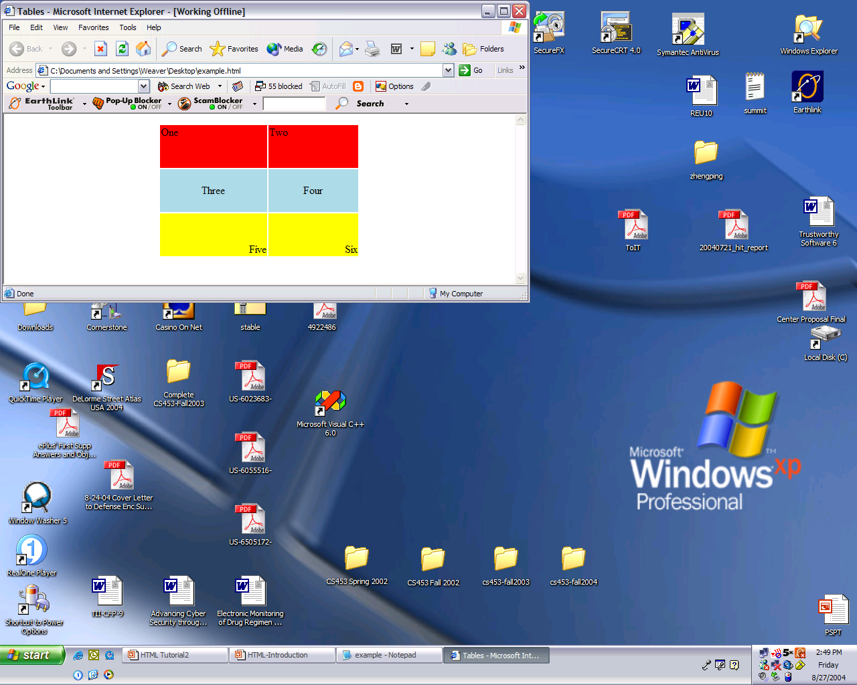
<tr> Table Row Attributes
Valid for the table row:
ALIGN -- left, center, right
VALIGN -- top, middle, bottom
BGCOLOR -- background color
<TABLE ALIGN="center" WIDTH="300" HEIGHT="200">
<TR ALIGN="left" VALIGN="top" BGCOLOR="red"><TD>One</TD><TD>Two</TD>
<TR ALIGN="center" VALIGN="middle" BGCOLOR="lightblue"><TD>Three</TD><TD>Four</TD>
<TR ALIGN="right" VALIGN="bottom" BGCOLOR="yellow"><TD>Five</TD><TD>Six</TD>
</TABLE>
Any use, copying or distribution without written permission from UnitedHealth Group is prohibited.

Slide 25
<td> Table Cell Attributes
Valid for the table cell:
colspan -- how many columns this cell occupies
rowspan – how many rows this cell occupies
<TABLE ALIGN="center" WIDTH="300" HEIGHT="200" border="1">
<TR>
<TD colspan="1" rowspan="2">a</TD>
<TD colspan="1" rowspan="1">b</TD>
</TR>
<TR>
<TD colspan="1" rowspan="1">c</TD>
</TR>
</TABLE>
Any use, copying or distribution without written permission from UnitedHealth Group is prohibited.

Slide 26
Frames
Frames help control navigation and display
<FRAME> attributes include
  FRAMEBORDER – yes or 1 for borders
  FRAMESPACING – width of border
  BORDERCOLOR – color
  SRC – location of HTML to display in frame
  NAME – destination for TARGET attribute
  MARGINWIDTH – left/right margins
  MARGINHEIGHT – top/bottom margins
  SCROLLING – yes or 1 adds scroll bar
  NORESIZE – yes or 1 disables resizing
Any use, copying or distribution without written permission from UnitedHealth Group is prohibited.

Slide 27
Frames
<FRAMESET ROWS="75%,25%">
<FRAMESET COLS="*,*,*">
<FRAME SRC="http://www.unitedhealthgroup.com">
<FRAME SRC="http://www.unitedhealthgroup.com">
<FRAME SRC="http://www.unitedhealthgroup.com">
</FRAMESET>
<FRAMESET COLS="*,*">
<FRAME SRC="http://www.unitedhealthgroup.com">
<FRAME SRC="http://www.unitedhealthgroup.com">
</FRAMESET>
</FRAMESET>
Any use, copying or distribution without written permission from UnitedHealth Group is prohibited.

Slide 28
Frames
<FRAMESET ROWS="*,*">
<FRAMESET COLS="15%, 2*, *">
<FRAME SRC="http://www.cs.virginia.edu/">
<FRAME SRC="http://www.cs.virginia.edu/">
<FRAME SRC="http://www.cs.virginia.edu/">
</FRAMESET>
<FRAMESET COLS="40%, *">
<FRAME SRC="http://www.cs.virginia.edu/">
<FRAME SRC="http://www.cs.virginia.edu/">
</FRAMESET>
</FRAMESET>
Any use, copying or distribution without written permission from UnitedHealth Group is prohibited.

Slide 29
Forms
HTML forms are used to collect user input.
The form tag <form> ... </form> is used to send user-specified information back to the server. The server then sends back its response, a new HTML document.
The form tag itself needs at least 2 attributes, the “action” attribute and the “method” attribute.
Although there are other methods, we generally use method=“post” for our interactive programs.
The “action” of a form is the program on the server that the form’s contents are sent to. That program processes the information and returns the response document.
The form sends name=value pairs to the server. “name” and “value” are both specified within each form element.
Any use, copying or distribution without written permission from UnitedHealth Group is prohibited.

Slide 30
Form Elements
  <input> Element –
  The <input> element has many variations, depending on the type attribute.
  “text” Defines normal text input
  “radio” Defines radio button input (for selecting one of many choices)
  “submit” Defines a submit button (for submitting the form)
Radio buttons: You typically use them in groups, all which have the same name but different values. Only one button can be checked; the parameter is given the value associated with the checked button. It is possible to have one button checked as a default, by putting the word "checked" after the value=par_value statement.
<input type=“radio” name="parameter“ value="par_value">
The parameter specified by the “value” attribute in the checked radio button is sent to the server.
Any use, copying or distribution without written permission from UnitedHealth Group is prohibited.

Slide 31
Form Elements
Check boxes: If checked, the value “TRUE” is sent to the server. If not checked, neither name nor value is sent to the server. If you want it checked by default, include the word “checked” within the tag.
<input type=“checkbox” name="parameter">
Text boxes: if you want to enter a single line of text. Whatever is typed into the box gets sent as a string to the program given by the form action mentioned above, as the value of a parameter whose name is given by "name=". You can change the size of the text box with the attribute “size”; its value is the number of characters that can be displayed:
<input type=“text” name="parameter“ size=“25”>
Any use, copying or distribution without written permission from UnitedHealth Group is prohibited.

Slide 32
Form Example
<!DOCTYPE html>
<html>
<body>
<form action="action_page.php">
First name:<br>
<input type="text" name="firstname" value="Mickey">
<br>
Last name:<br>
<input type="text" name="lastname" value="Mouse">
<br><br>
<input type="radio" name="sex" value="male" checked>Male
<br>
<input type="radio" name="sex" value="female">Female
<br><br>
<input type="submit" value="Submit">
</form>
<p>If you click "Submit", the form-data will be sent to a page called "action_page.php".</p>
</body>
Any use, copying or distribution without written permission from UnitedHealth Group is prohibited.

Slide 33
Form - <select> element (Dropdown list)
The <select> element defines a drop-down list
The <option> elements defines the options to select.
Ex:
<select name="cars">
<option value="volvo">Volvo</option>
<option value="saab">Saab</option>
<option value="fiat">Fiat</option>
<option value="audi">Audi</option>
</select>
The list will normally show the first item as selected.
You can add a selected attribute to define a predefined option.
Ex:
<option value="fiat" selected>Fiat</option>
To allow the user to select multiple options, use the keyword “multiple” in the <select> tag: <select multiple name=“cars”>
Any use, copying or distribution without written permission from UnitedHealth Group is prohibited.

Slide 34
Other Form Elements
<textArea> -
The <textarea> element defines a multi-line input field (a text area)
Ex:
<textarea name="message" rows="10" cols="30">
The cat was playing in the garden.
</textarea>
<button> -
The <button> element defines a a clickable button
Ex:
<button onclick="alert('Hello World!')">Click Me!</button>
Any use, copying or distribution without written permission from UnitedHealth Group is prohibited.

